Slide 1
ENVIRONMENTAL AUDIT REPORT OF OUR SCHOOL
Disha Rodrigues, Shravya R.C, Rishith.H
Grade : 8 th
Affiliated to CBSE ,New Delhi
12/1/2022
LAKE 2022: Conservation of wetlands: ecosystem-based adaptation of climate change, December 28-30, 2022
1

Slide 2
INTRODUCTION
Environmental audit is defined as an official examination of the effects a school has on the environment
It helps to improve the existing practices with the aim of reducing the adverse effects of these on the environment concerned
Self-enquiry is a natural and expected development of quality education. Therefore, it is necessary that the institution must evaluate its contribution to a sustainable future
It can create health awareness and promote environmental awareness and ethics

Slide 3
OBJECTIVES
To recognize the initiative taken by the school/institution towards environmental conservation
To understand and recognize the effects of an organization on the environment and vice-versa
To study about the biodiversity of the school
To check the green practices followed by our school
To conduct a well formulated report to understand where we stand on environmental soundness

Slide 4
METHODOLOGY
A green audit has three stages
Pre-audit stage- Involves identification of the target areas for auditing. The following target areas were identified;
Land use system
Biodiversity status
Climatic conditions
Energy consumption
Water resources and management
Audit stage- Involves collection of data, observation and interaction
Post-audit stage- Include production of final report, prepare an action plan to overcome the flaws and keep a watch on the action plan

Slide 5
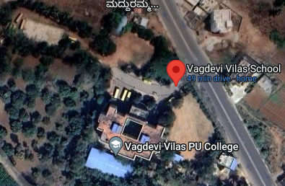
AUDIT STAGE
LAND USE-SYSTEM
VVSB campus provides a distinctive and joyful, pollution free and pleasant environment amidst green and serene atmosphere
A huge playground with Basket Ball and Volley Ball courts, athletic tracks.
Science Tech Park where students ‘do science’ and ‘ learn by doing’ .
There is an exclusive Khanija Bhavana that showcases an array of minerals in their original extracted form set up with the help of Mines and Geology Department, Govt. of India
Vagdevi Vilas School Bidadi
Coordinates- 12.7421° N, 77.4302° E

Slide 6
AUDIT STAGE CLIMATIC PARAMETERS
This area in which the school is located has a tropical climate.
In winter, there is much less rainfall than in summer
The temperature here averages 24.0 °C | 75.1 °F. About 952 mm | 37.5 inch of precipitation falls annually
The month with the highest relative humidity is August (78.28 %). The month with the lowest relative humidity is March (40.90 %).
The month with the highest number of rainy days is July (19.00 days). The month with the lowest number of rainy days is January (1.47 days).

Slide 7
BIODIVERSITY STATUS- PLANT SPECIES
SERIAL NUMBER | COMMON NAME | BOTANICAL NAME | NUMBER
01 | Chili pepper | Capsicum annum | 216
02 | Papaya | Carica papaya | 54
03 | Coconut | Cocos nucifera | 33
04 | Indian almond | Terminalia catappa | 73
05 | Key lime | Citrus aurantifolia | 4
06 | Common guava | Psidium guajava | 10
07 | Princess vine | Cissus verticillata | 17

Slide 8
BIODIVERSITY STATUS-PLANT SPECIES
SERIAL NUMBER | COMMON NAME | BOTANICAL NAME | NUMBER
08 | Creeping false holly | Jaltomata procumbens | 3
0 | Summer grapes | Vitis aestivalis | 5
10 | Tamarind tree | Tamarindus indica | 5
11 | Cabbage | Brassica oleracea | 63
12 | Okra/lady’s finger | Abelomoschus esculentus | 143
13 | Mango | Magnifera indica | 8
14 | Watermelon | Citrullus lanatus | 14

Slide 9
BIODIVERSITY STATUS- BUTTERFLIES
SERIAL NUMBER | Common name | Zoological name
01 | Common palmfly | Elymnias hypermnestra
02 | Chocolate pancy | Junonia iphita
03 | Lemon pansy | Junonia lemonias
04 | Common grass yellow | Eurama hecabe
05 | Common castor | Ariadne marione
06 | Citrus swallow tail | Papilio demodocus
07 | Common mormon | Papilio polytes

Slide 10
BIODIVERSITY STATUS- SPIDERS
SERIAL NUMBER | Common name | Zoological name
01 | Dome tent spider | Crytophora moluccenis
02 | Giant golden orb weaver | Nephilia
03 | Giant wood spider | Nephila pilipes
04 | House spider | Parasteatoda tepidariorum
05 | Yellow spider | Cheiracanthium inclusum
06 | Daddy long legs spider | Pholcus phalangioides
07 | Orb-weaver spider | Anepsion maritatum

Slide 11
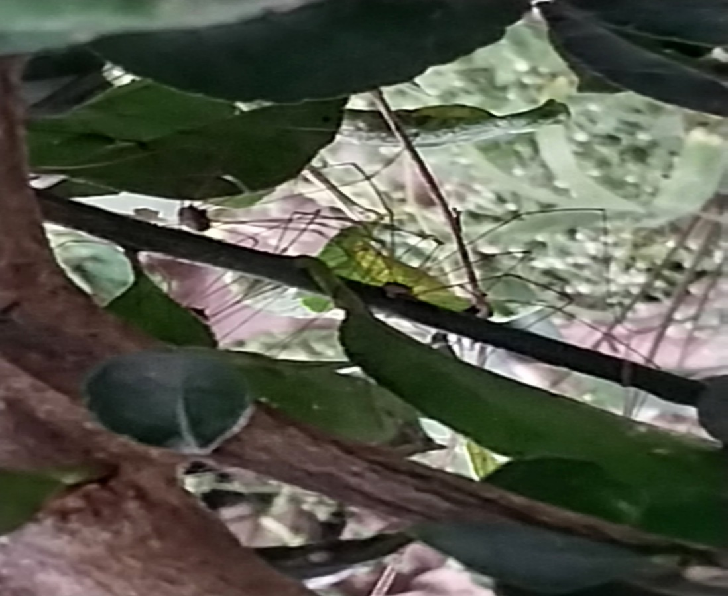
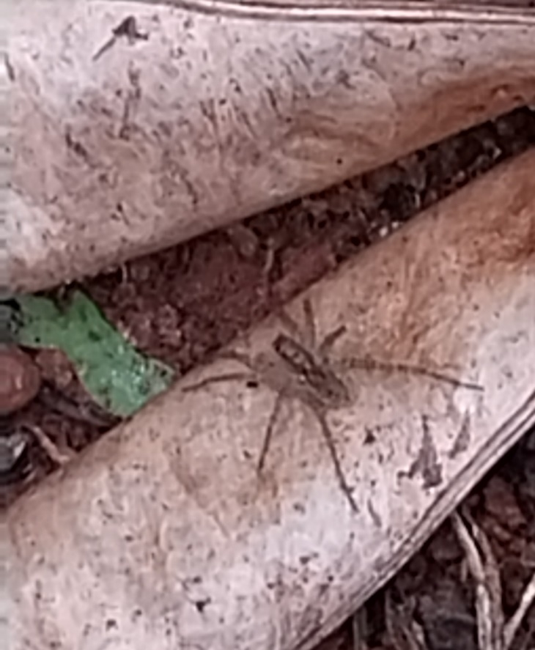
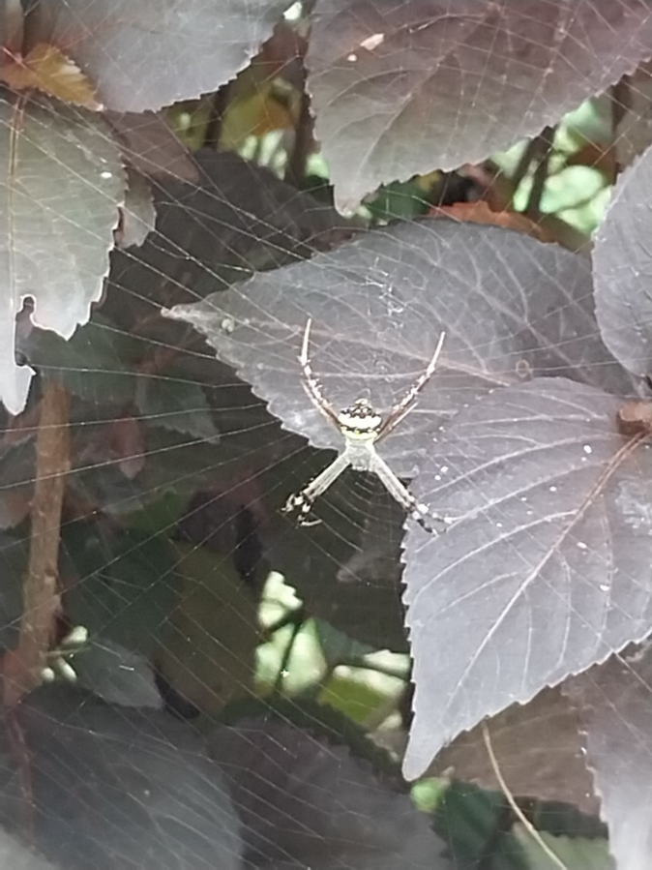
BIODIVERSITY STATUS- SPIDERS

Slide 12
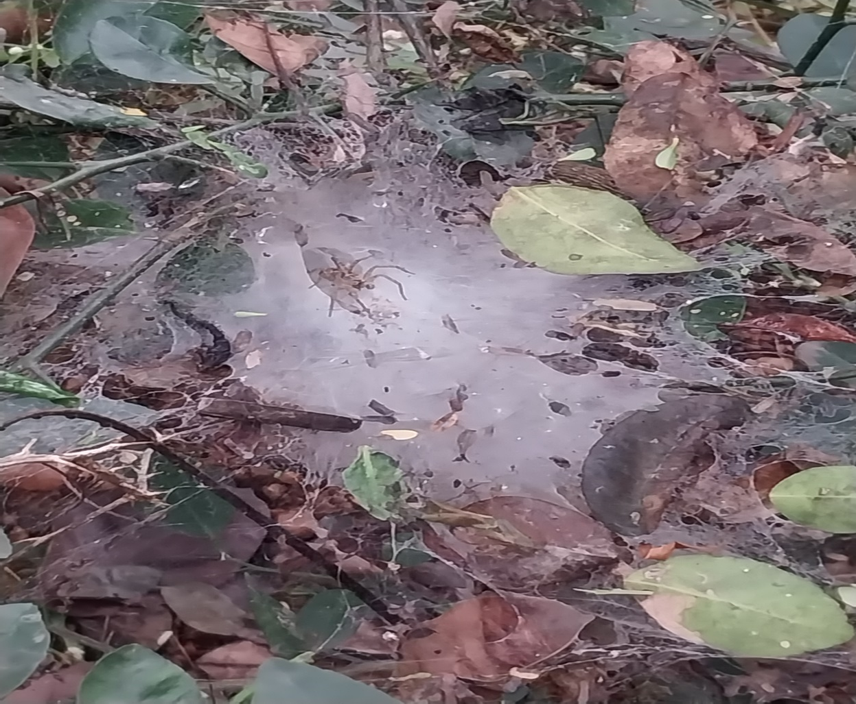
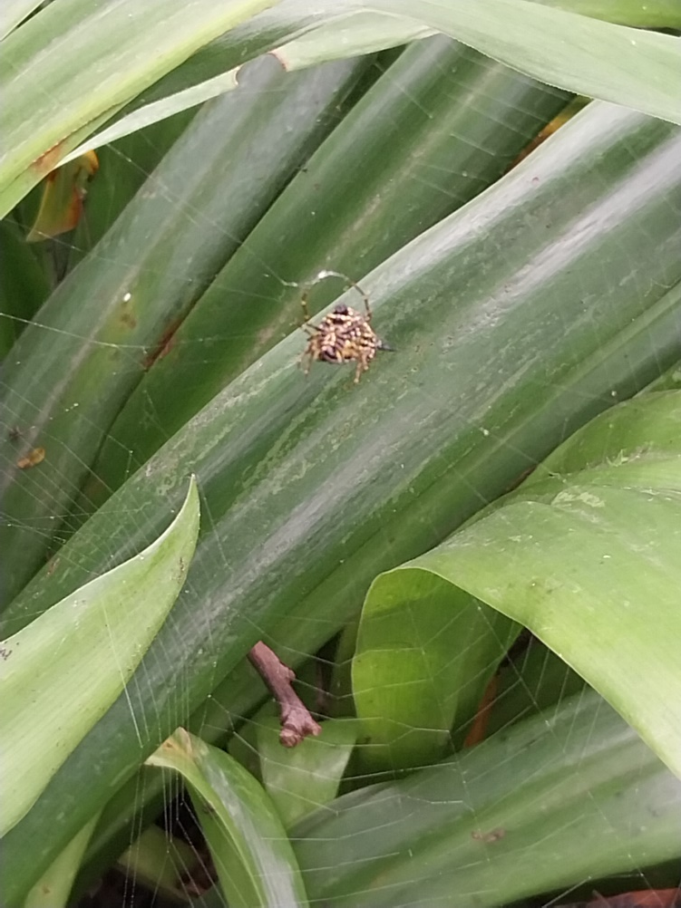
BIODIVERSITY STATUS- SPIDERS

Slide 13
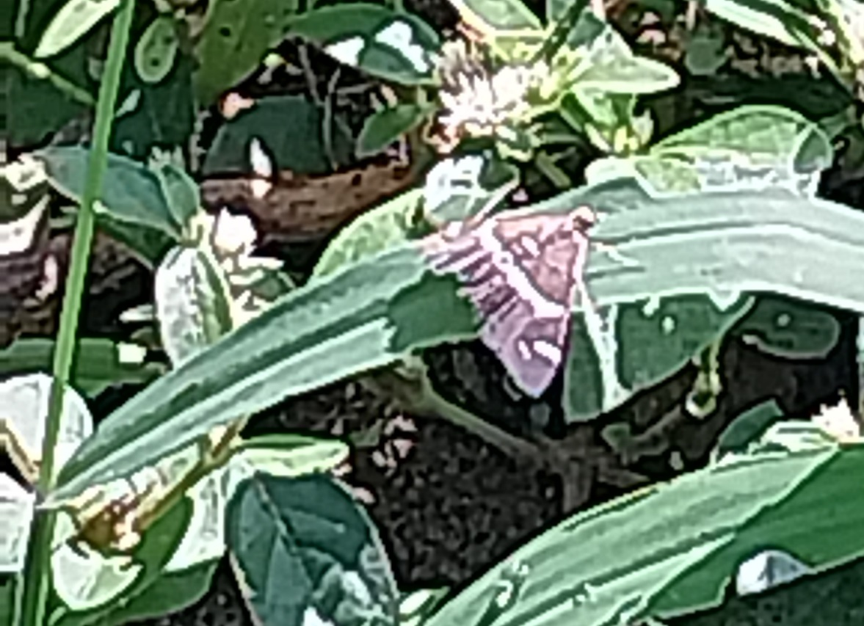
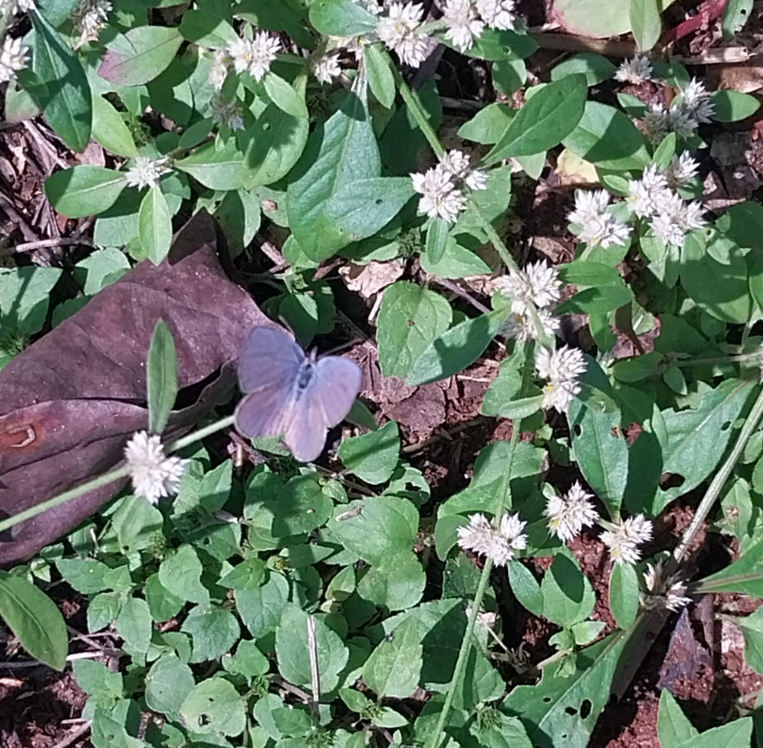
BIODIVERSITY STATUS- BUTTERFLIES

Slide 14
BIODIVERSITY STATUS- REPTILES
Serial number | Zoological name | Common name
01 | Calotes spp | Garden lizard
02 | Hemidactylis spp | Common house gecko
03 | Ptyas mucocus | Rat snake

Slide 15
WATER CONSERVATION MEASURES
Rain water harvesting is practiced rigorously at Vagdevi Vilas Institutions with several percolating and harvesting wells in each premises.
There is a rainwater re-usage facility also by harnessing the terrace water through proper pipelines and filters which is stored in an underground RCC tank of 2,00,000 litre capacity which is used for gardening and sanitary maintenance.

Slide 16
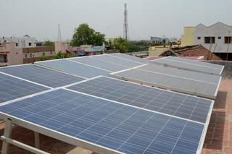
ENERGY CONSERVATION MEASURES
Vagdevi Vilas School, an educational institution- MARATHALLI BRANCH has announced the successful installation of a 100 kW rooftop solar plant in its campus by partnering with Tata Power Solar.

Slide 17
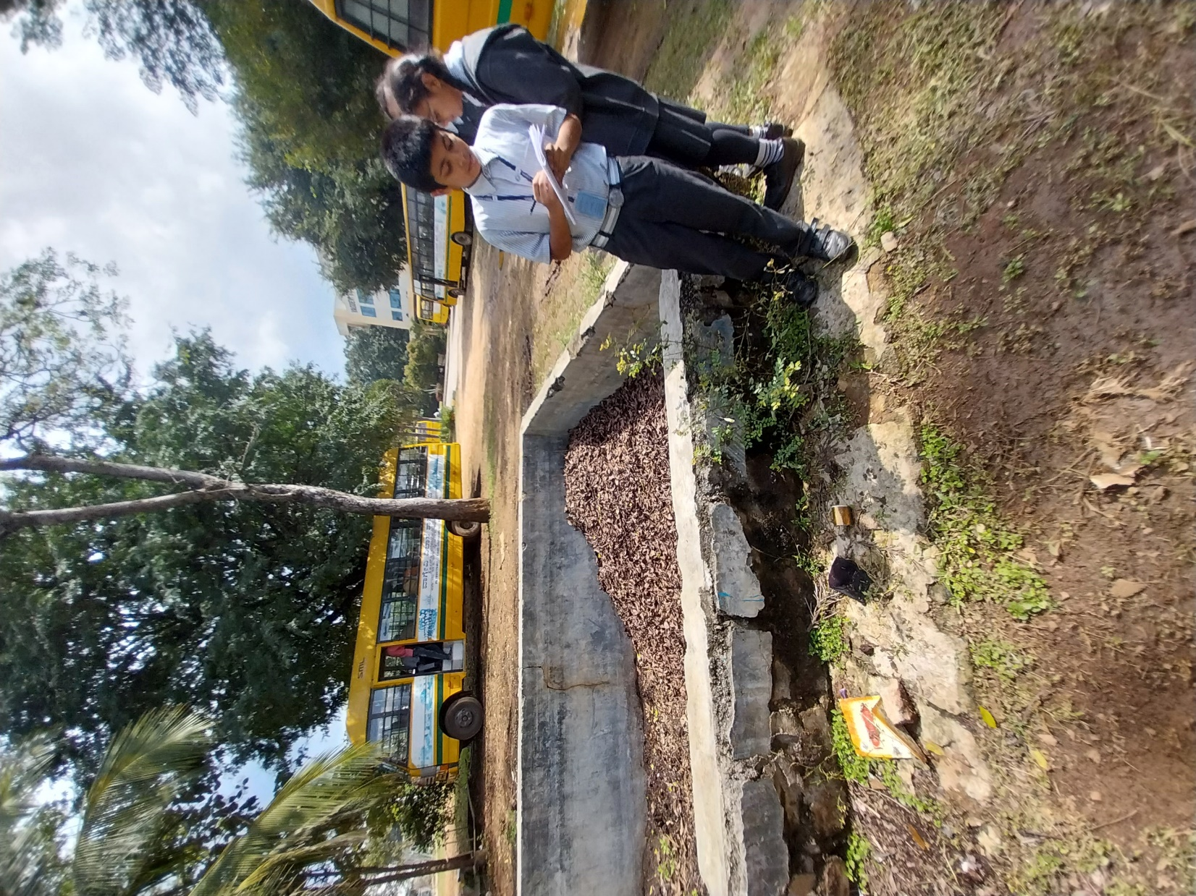
MITIGATION AND MANAGEMENT PRACTICES
Organic composting

Slide 18
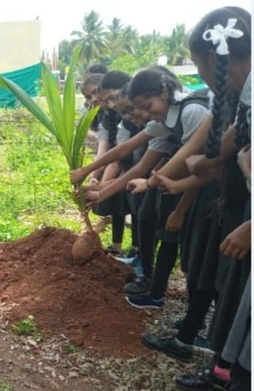
MITIGATION AND MANAGEMENT PRACTICES
PLANTATION DRIVES

Slide 19
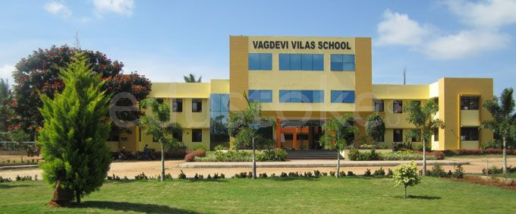
MITIGATION AND MANAGEMENT PRACTICES
MAINTENANCE OF LUSH GREEN CAMPUS

Slide 20
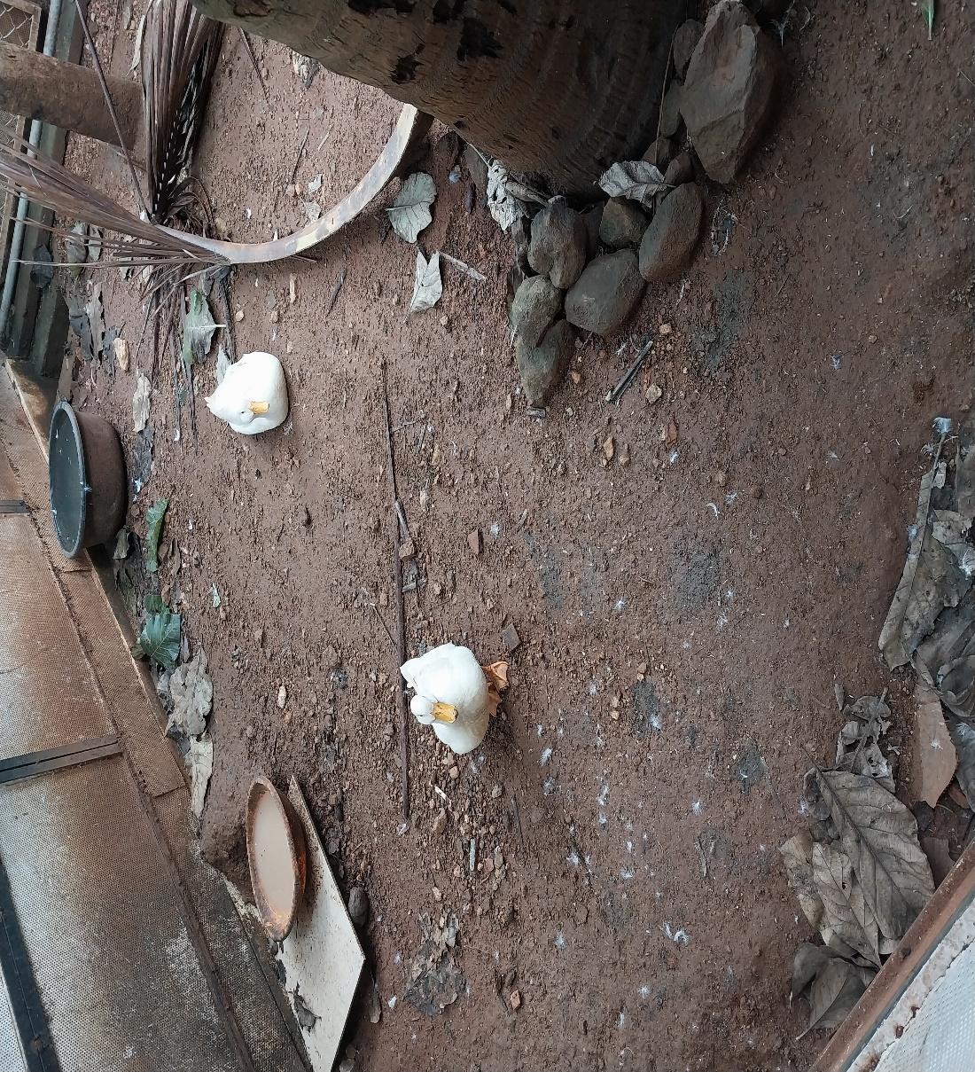
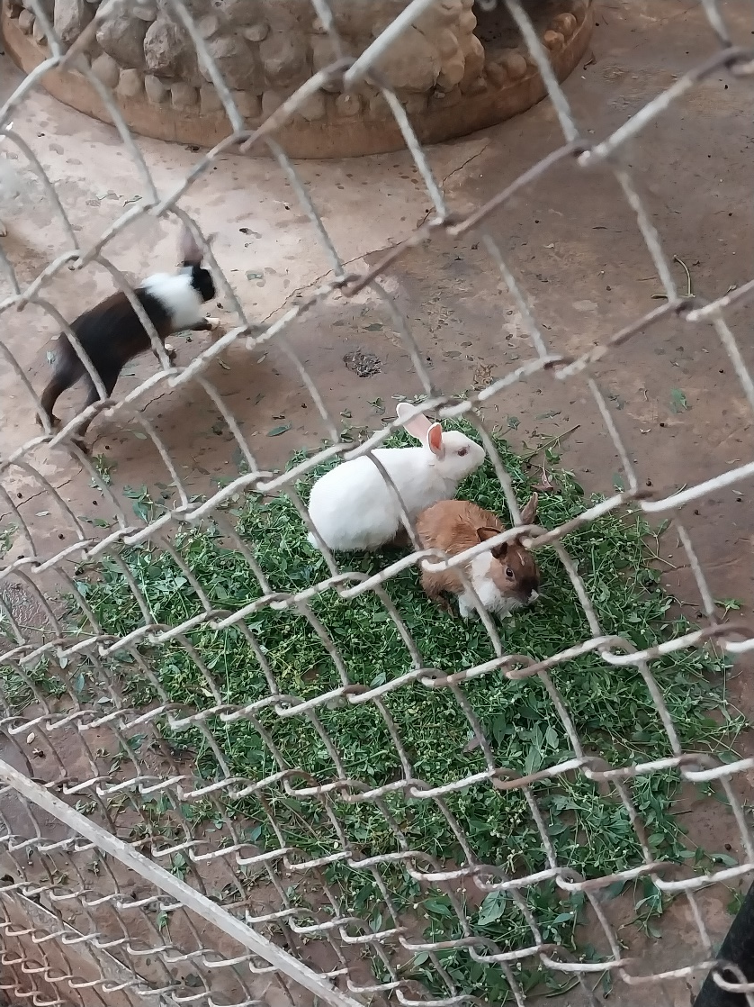
MITIGATION AND MANAGEMENT PRACTICES

Slide 21
RECOMMENDATIONS
As an outcome efforts, focus to assess the consumption of energy, electricity, water consumption, disposal of liquid waste, e-waste planting the new saplings to reduce carbon foot prints
Various awareness programs will be helpful to motivate all the staff members for optimized sustainable use of available resources
The long term goal is to collect baseline data of environmental parameters and resolve environmental issue

Slide 22
CONCLUSION
Traditionally we are good and efficient users of natural resources
But over the period of time excess use of resources have become habitual especially in common areas
It is necessary to check whether our activities are consuming more than required resources
Audit helps to regulate all such practices and gives an efficient way of natural resource utilization
In the era of climate change and resource depletion it is necessary to verify the process and convert it to green and clean one

Slide 23
REFERENCES
NEP 2006. National environmental policy, 2006. Ministry of environment, Forest and climate change, Govt
Patil., Langi. B., Gaurav. M. 2018. Green audit in academic institutes. International journal of multidisciplinary educational research 8
Green audit report 2021-22. Uttarakhand open university.

Slide 24
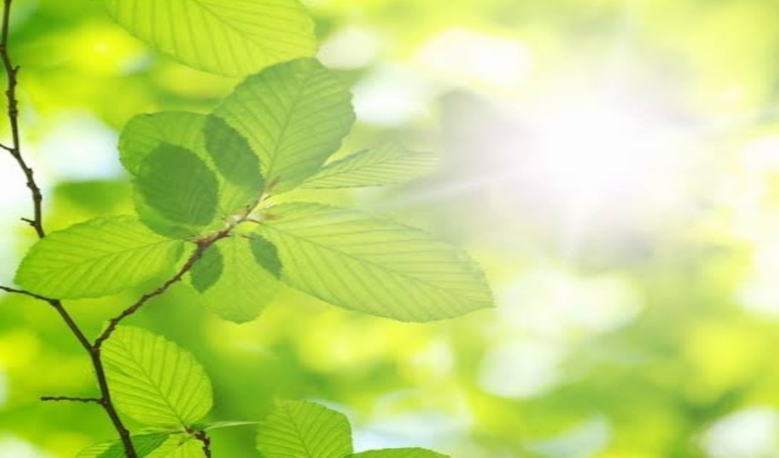
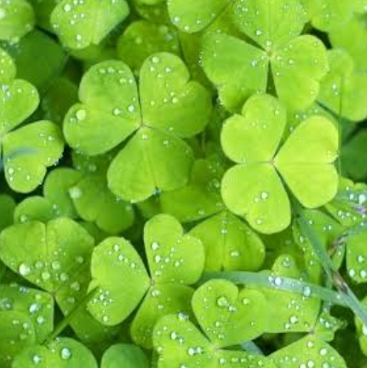
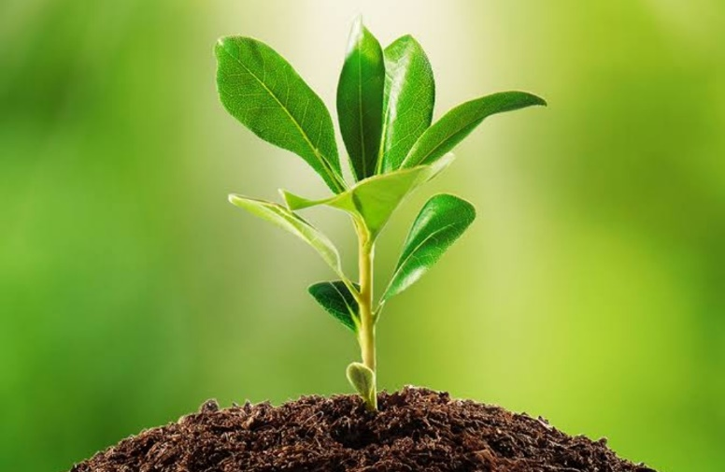
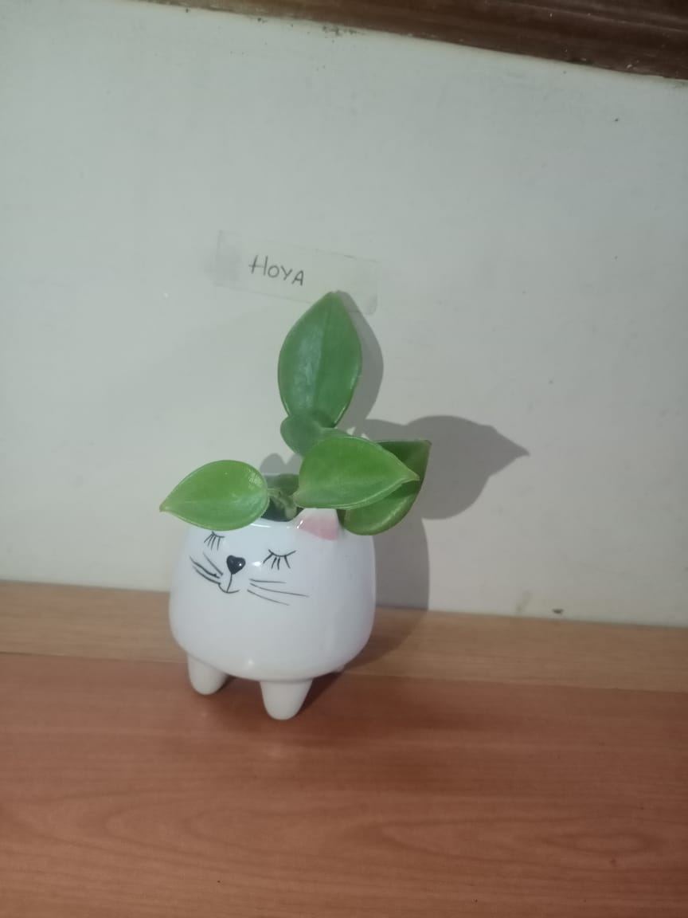
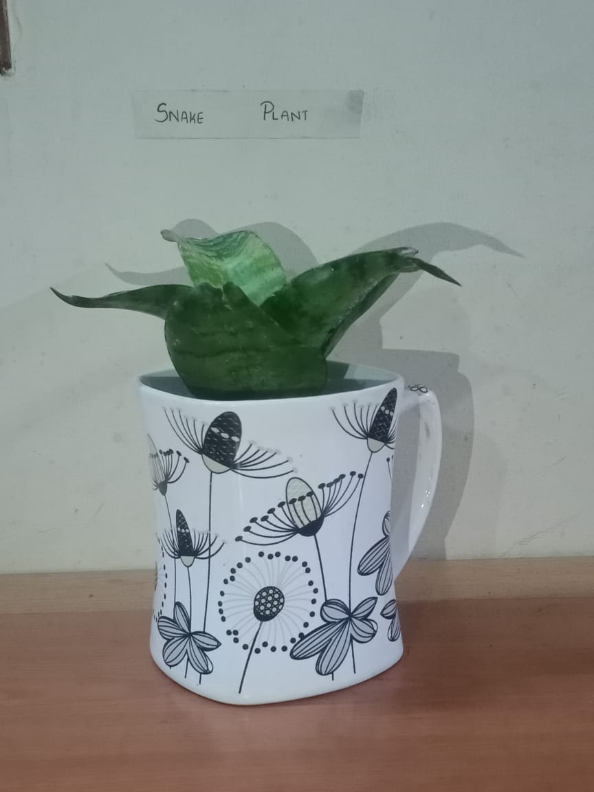
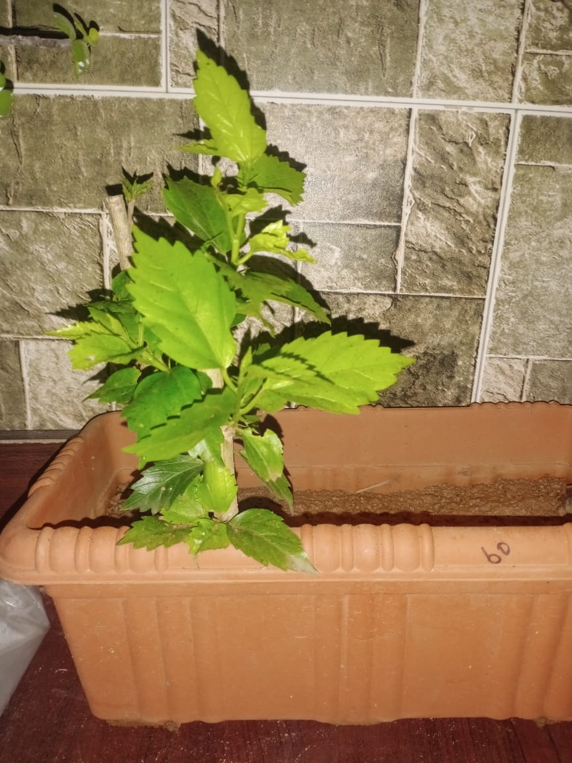
THANK YOU

